Slide 1



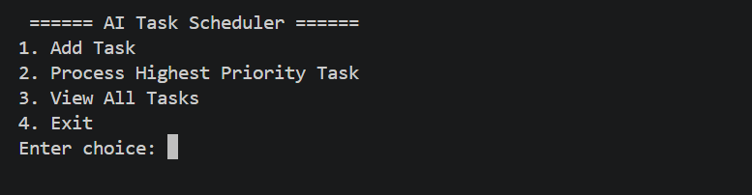
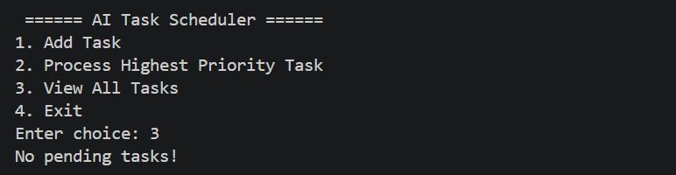
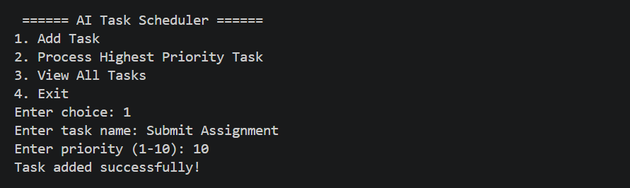
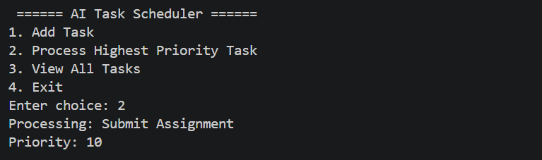
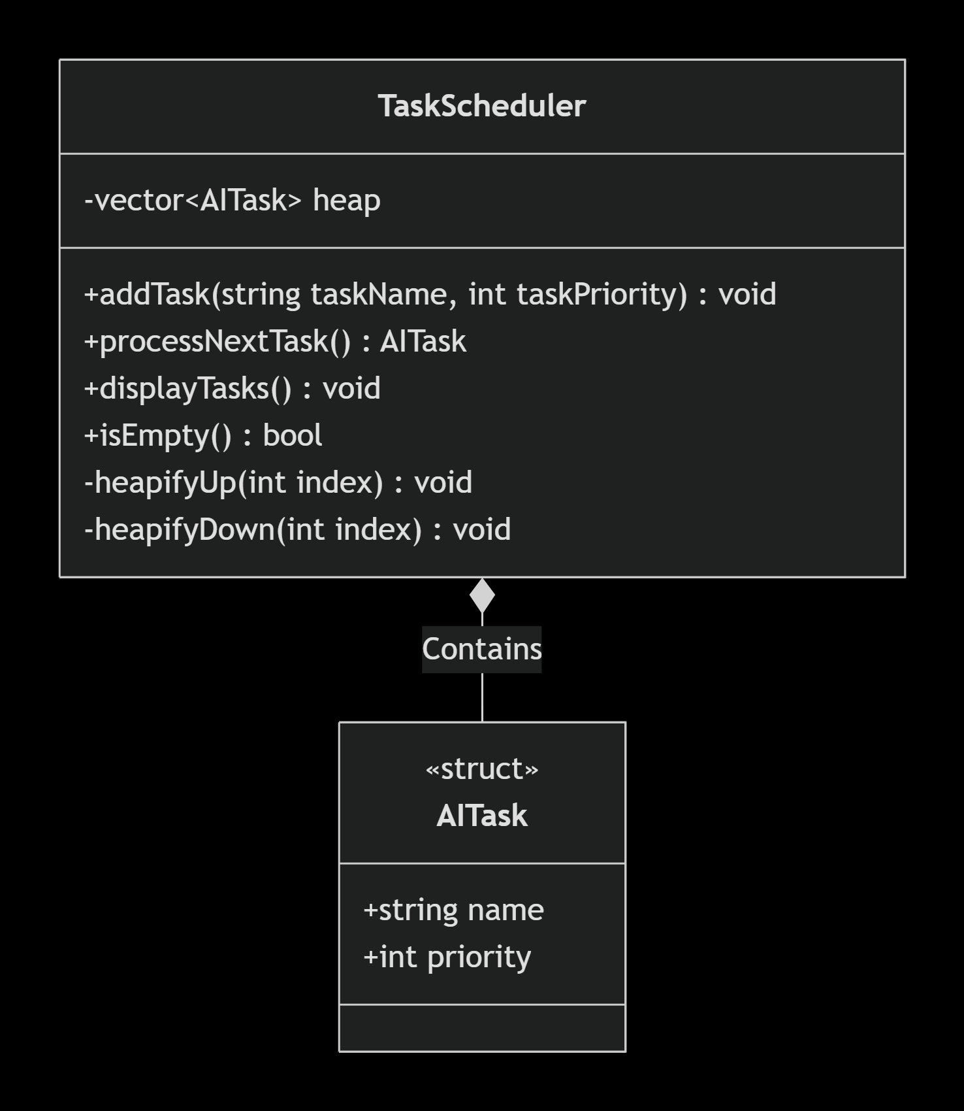
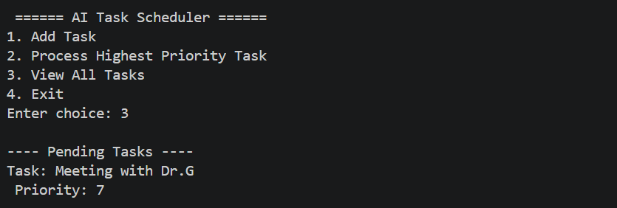

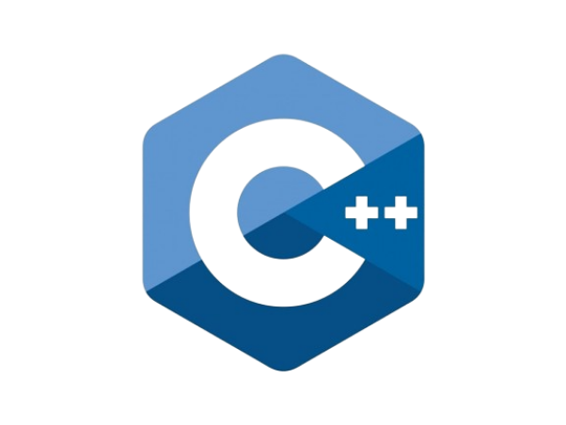


Design and Implementation of an AI Task Priority Scheduler using a
Max-Heap
Raj Kumar Giri
Dr. Victor Govindaswamy
Concordia University Chicago
Abstract
Further Future Work
Menu Functionality
Edge Case Handling (Empty Queue)
Field: This project, situated within the realm of Computer Science and Artificial Intelligence, focuses on data structure implementation and algorithmic efficiency. It utilizes a Priority Queue (Max-Heap) to solve the real-world problem of task scheduling in AI systems.
Purpose: The primary of this project is to enable autonomous systems to prioritize critical tasks (e.g. safety protocols) over background tasks (e.g. data logging). This is achieved by implementing a menu-driven C++ application where tasks are assigned priority levels. The Max-Heap ensures the highest priority tasks is always processed first in (log n) time. Additionally, the program allows for viewing all pending tasks in order of importance.
Future Enhancements: Future iterations of this project involve implementing a Graphical User Interface (GUI) for easier interaction, adding multithreading for concurrent task processing, and allowing dynamic updates to a task’s updates to a task’s priority while it is still in the queue.
Persistent Storage: Integrating a database (like SQLite or Amazon DynamoDB) so that pending AI tasks are not lost if the system restarts.
Machine Learning Integration: Using a Machine Learning (ML) model to automatically assign priority levels based on real-time sensor data, rather than relying on hardcoded integer inputs.
Sorting Stability: Implementing a secondary “timestamp” check to ensure that if two tasks have the exact same priority., they are processed in the exact order they arrived First In First Out (FIFO).
In this application, users can manipulate and interact with the task list using a terminal menu. This ensures users know exactly what operations are available.
This project uses Exception Handling (try-catch).
If a user tries to process a task when the queue is completely empty, the system does not crash. It catches a runtime-error and alerts the user gracefully.
1: Add Task
Option 1 allows the user to input a task name and assign it a priority from 1 to 10. The program uses cin.ignore() and getline() to properly capture task names that contain spaces.
Complexity Analysis
Time Complexity:
Insert (Add Task): O(log n) – The new task “bubbles up” the tree.
Extract (Process Task): O(log n) – the root is removed and the tree “sinks down”.
Peek (View top): O(1) – Instant access.
Space complexity:
O(n) – Memory is used proportionally to the number of tasks currently in the scheduler. We do not allocate a massive fixed array, it grows dynamically.
Priority Queue/Max-Heap
A Priority Queue is a data structure where each element has a “priority”. Element with higher priorities are served before lower ones.
In this project, a Max-Heap is used. A Max-Heap is a complete binary tree where every parent node is greater than or equal to its children.
Because of this, the highest priority task is always at the root (index 0).
Complexity: Insertion and extraction are extremely fast O(log n), making it highly scalable for AI workloads.
2: Process Highest Priority Task
It allows the system to extract and process the most critical task. It removes the root node, replaces it with the last element, and triggers heapifyDown to restore the Max-Heap property.
Code Highlight: Heapify Logic
UML Organizational Chart
Advantages & Disadvantages
The core of the application relies on simple math to navigate the tree without using pointers:
Parent: (index -1) /2
Left Child: (2 * index) + 1
Right Child: (2 * index) + 2
This allows the tree to be stored in a flat array/vector, saving memory and improving CPU cache performance.
Advantages:
Extremely fast access to the highest priority element O(1) peek.
Efficient insertions and deletions O(log n).
Dynamic memory allocation.
Disadvantage:
Searching for a specific task in the middle is slow O(n).
Not stable (items with the same priority might not maintain FIFO order).
Heapify logic is complex to code from scratch.
3: View all Tasks
Option 3 displays all tasks currently waiting in the queue. Because a heap is not fully sorted, the program copies the heap, sorts the copy, and displays the output so the user sees the tasks in order of priority.
Contacts
Bioinformatics And Technology Laboratory (BAT Lab)
Programming Application Implementation and Design (PAID)
Computer Science Department (CSC@CUC)
Member: Raj Kumar Giri
Advisor: Dr Visvasuresh (Victor) Govindaswamy
Email: Victor.Govindaswamy@cuchicago.edu
Address: Concordia Chicago University
7400 Augusta Street
River Forest, IL, 60305-1499
Object-Oriented Programming (OOP)
OOP revolves around the use of classes and objects. This project adheres to this paradigm through Encapsulation:
The heap vector, heapifyUp, and heapifyDown methods are kept private inside the TaskScheduler class.
This prevents the user or main program from accidentally corrupting the tree structure.
The AITask is implemented as a struct to keep the task name and priority glued together as single data package, ensuring they are never separated during swaps.
3: View all Tasks
Option 4 allows the user to safely and gracefully exit the scheduler. When selected, the program breaks out of the continues do-while menu loop, ensuring that all dynamic memory used by the Max-Heap vector is automatically cleared by the C++ runtime. The program then returns a 0 to the operating system, indicating a successful and clean termination of the application.
Technologies Used

